Slide 1
EMOJI AWARE
Activity adapted from: Adler, R. B., Rodman, G. R., & DuPré, A. (2012). In Understanding human communication, Activity: Emoti-pros and cons. New York, NY: Oxford University Press.

Slide 2
EMOJI AWARE
Do you use this emoji? Why or why not?
Without consulting outside sources, what does the emoji mean to you?
In what context would you use it? (audience, situation, etc.)

Slide 3
EMOJI AWARE
Do you use this emoji? Why or why not?
Without consulting outside sources, what does the emoji mean to you?
In what context would you use it? (audience, situation, etc.)

Slide 4
EMOJI AWARE
Do you use this emoji? Why or why not?
Without consulting outside sources, what does the emoji mean to you?
In what context would you use it? (audience, situation, etc.)

Slide 5
EMOJI AWARE
Do you use this emoji? Why or why not?
Without consulting outside sources, what does the emoji mean to you?
In what context would you use it? (audience, situation, etc.)

Slide 6
EMOJI AWARE
Do you use this emoji? Why or why not?
Without consulting outside sources, what does the emoji mean to you?
In what context would you use it? (audience, situation, etc.)

Slide 7
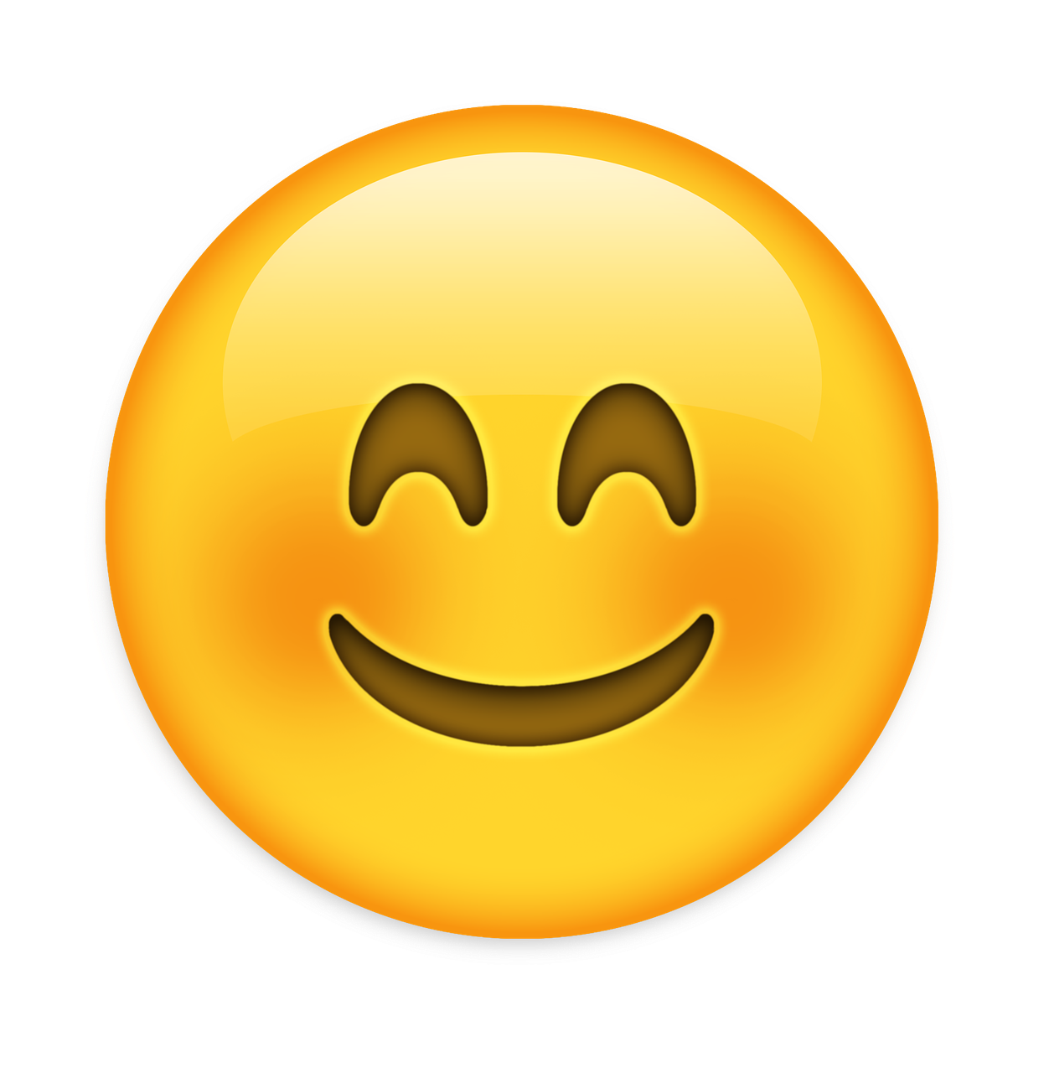
EMOJI AWARE
Do you use this emoji? Why or why not?
Without consulting outside sources, what does the emoji mean to you?
In what context would you use it? (audience, situation, etc.)

Slide 8
EMOJI AWARE
Do you use this emoji? Why or why not?
Without consulting outside sources, what does the emoji mean to you?
In what context would you use it? (audience, situation, etc.)

Slide 9
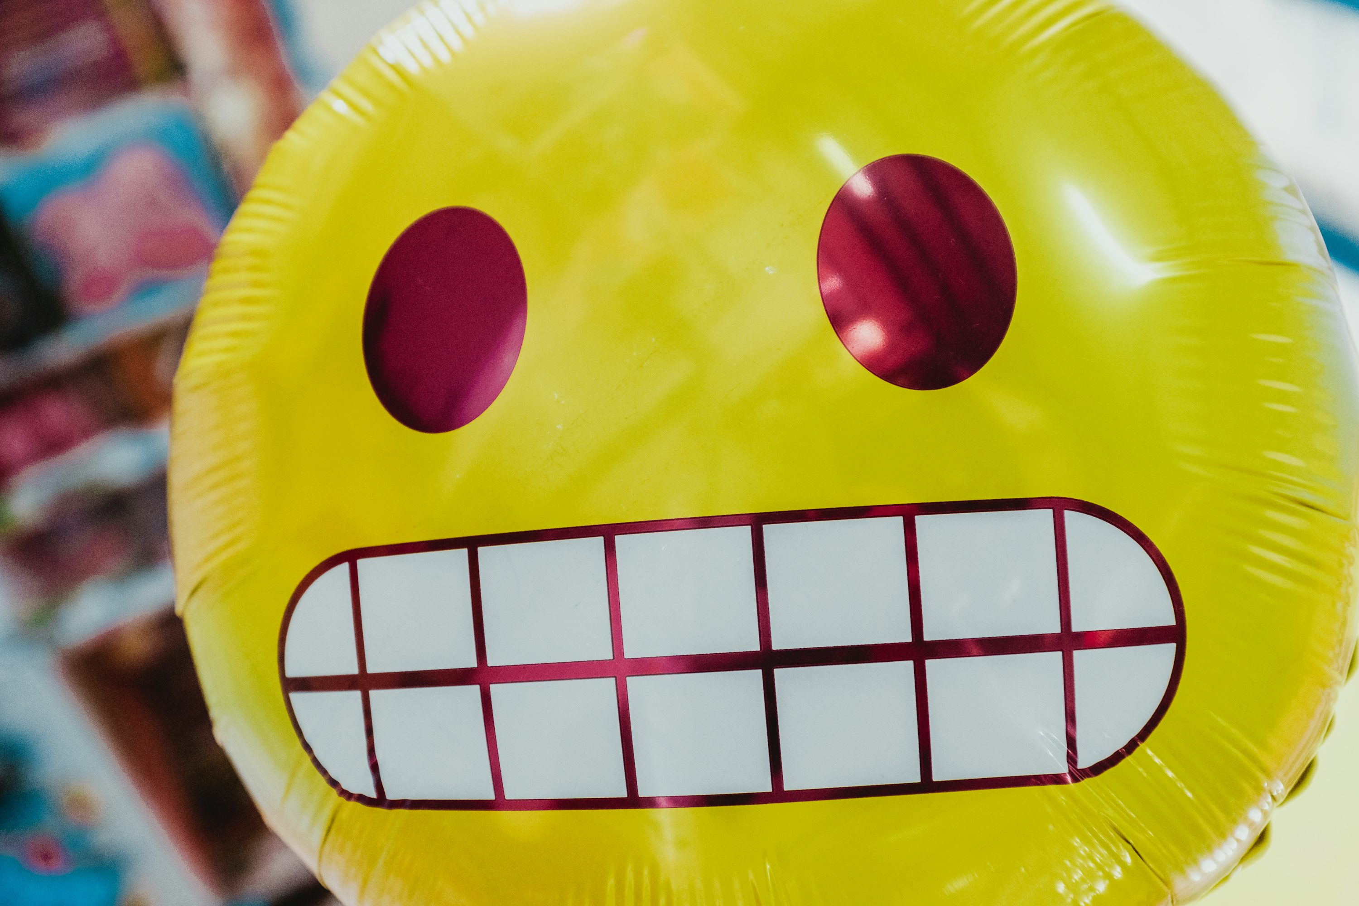
EMOJI AWARE
Do you use this emoji? Why or why not?
Without consulting outside sources, what does the emoji mean to you?
In what context would you use it? (audience, situation, etc.)

Slide 10
EMOJI AWARE
Do you use this emoji? Why or why not?
Without consulting outside sources, what does the emoji mean to you?
In what context would you use it? (audience, situation, etc.)

Slide 11
EMOJI AWARE
Do you use this emoji? Why or why not?
Without consulting outside sources, what does the emoji mean to you?
In what context would you use it? (audience, situation, etc.)

